Slide 1
Register file
An overview of the register file for a 64-bit single cycle processor

Slide 2
What is the register file?
Register file is an array of registers used to stage data between memory and the ALU. It supports nearly all instructions because most all instruction sets always define registers to stage data between memory and function units such as the ALU.

Slide 3
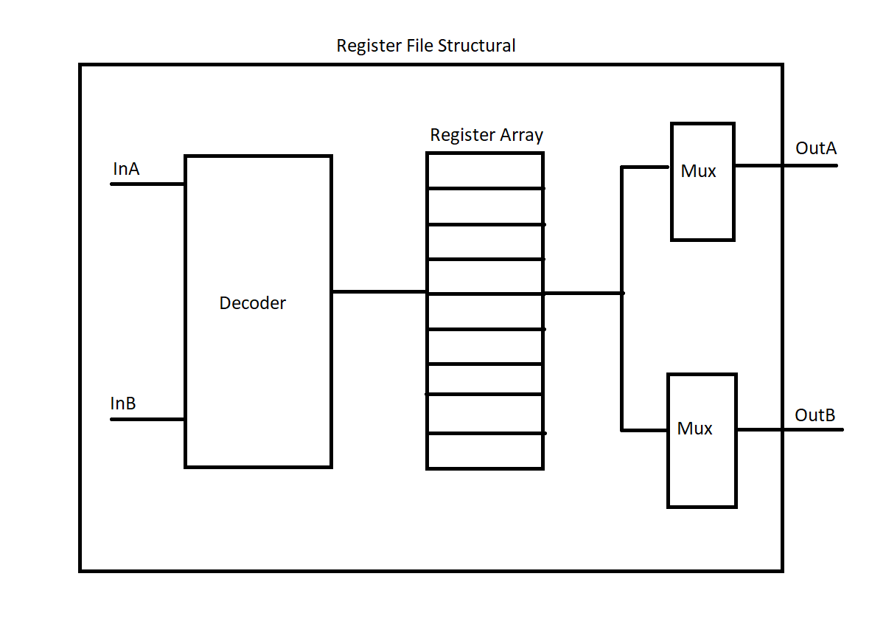
Which style should be used in order to implement?
This is a very rough diagram of a structural implementation of the register file. A 64-bit version of this structural style will get very complex very quickly. The preferred implementation is behavioral style.

Slide 4


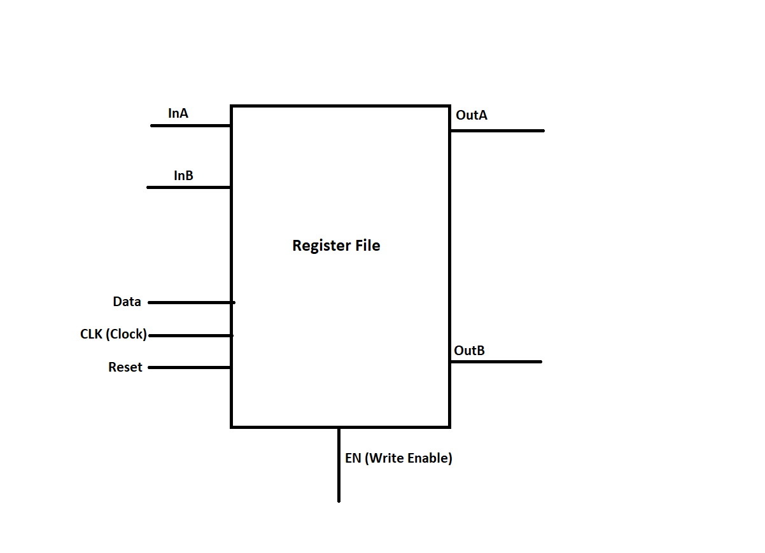
Behavioral diagram of our Register file.
Tips for implementation:
Once you understand how the Register File operates the implementation is not too bad. There are basically 3 scenarios for our CPU to worry about with the register file. Resetting, writing and reading. Resetting is iterating through all the registers in the array and wiping them. Writing is moving the data input and putting it into a register and reading is simply reading registers. In our implementation we have a reset signal, a write enable signal and if those are both off we are reading.

